Slide 1

Chapter 29
Communicating via WebSockets

Slide 2
Learning Objectives
How to test for browser support for the WebSocket API
How to use a socket for data communication
How to use the WebSocket API to send and receive messages to and from a remote server

Slide 3
Understanding sockets
To communicate across the web, two programs must establish a connection, normally using TCP/IP, across which they send and receive messages.
Think of a socket as an end point to the connection.
Developers use the term sockets to describe the end points and the communication channel.
This chapter examines the use of the WebSocket API to open, use, and later close a communication channel.

Slide 4
Testing Browsers for WebSocket Support
<!DOCTYPE html> <html> <head> <script> function testSocketSupport() { if (window.WebSocket) alert("Sockets Supported"); else alert("Sockets Not Supported"); } </script> </head> <body onload="testSocketSupport()"> </body> </html>

Slide 5
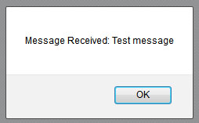
Exchanging Messages With a WebSocket Server
To perform server-based WebSocket communication, you need a server application that supports such communication.
Across the Web, you can find webSocket servers written in PHP, Python, Java, and more. Several of the servers let you run them on your own localhost.
To make it easy for you to get started, the Websocket.org website provides an “echo server,” which echos back messages it receives from a client.
The following HTML file, SocketEcho.html, connects to the server and sends a text message. When the server receives and echos the message back, the webpage will display the received message within an alert dialog box.

Slide 6
Socketecho.html
<!DOCTYPE html> <html> <head> <script> varwebsocket; function testSocketSupport() { if (window.WebSocket) { varServerURL = "ws://echo.websocket.org/"; websocket = new WebSocket(ServerURL); websocket.onopen = function(evt) { openFunction(evt) }; websocket.onclose = function(evt) { onClose(evt) }; websocket.onmessage = function(evt) { onMessage(evt) }; websocket.onerror = function(evt) { onError(evt) }; } else alert("Sockets Not Supported"); } function openFunction(event) { sendMessage("Test message"); } function onMessage(event) { alert("Message Received: " + event.data); }

Slide 7
continued
function onClose(event) { alert(event.data); } function onError(event) { alert(event.data); } function sendMessage(msg) { websocket.send(msg); } </script> </head> <body onload="testSocketSupport();"> </body> </html>

Slide 8
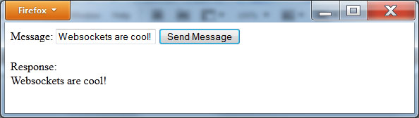
A second example
The following HTML file, AskMessage.html, prompts you for a message. When you click the Send button, the page uses a WebSocket to send the message to the server. The page then displays the message it receives back within the form.

Slide 9
Askmessage
<!DOCTYPE html> <html> <head> <script> varwebsocket;
varsocketsSupported = false; function Initialize() { if (window.WebSocket) { varServerURL = "ws://echo.websocket.org/"; websocket = new WebSocket(ServerURL); websocket.onopen = function(evt) { openFunction(evt) }; websocket.onclose = function(evt) { onClose(evt) }; websocket.onmessage = function(evt) { onMessage(evt) }; websocket.onerror = function(evt) { onError(evt) }; alert('Establishing Connection'); while (websocket.readyState == websocket.CONNECTING) ; // wait until socket is connected socketsSupported = true; } else alert("Sockets Not Supported"); }

Slide 10
continued
function Send(msg) { Initialize(); if (socketsSupported) websocket.send(msg); } function onMessage(event) { document.getElementById('response').innerHTML = event.data; } function onClose(event) { alert(event.data); } function onError(event) { alert(event.data); } </script> </head> <body> Message: <input id="msg" type="text"></input> <button onclick="Send(document.getElementById('msg').value)">Send Message</button> <br/><br/> Response: <div id="response"></div> </body> </html>

Slide 11
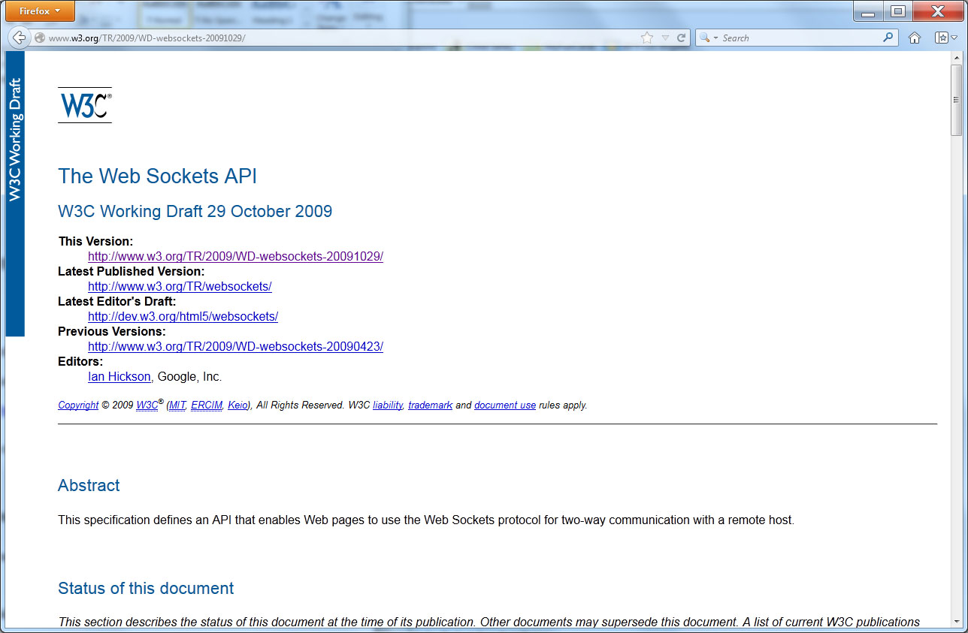
Real world design – web socket api

Slide 12
summary
As you surf the Web, you undoubtedly have seen sites that let you “chat with a representative” in real time using a text-based chat.
To make it easier for developers to integrate such capabilities into the sites they create, HTML 5 provides a WebSocket API.
This chapter introduces the API and how you can use it to communicate with a remote server.
Over time, we can expect the API to continue to provide new capabilities, such as peer-to-peer communication.

